Slide 1
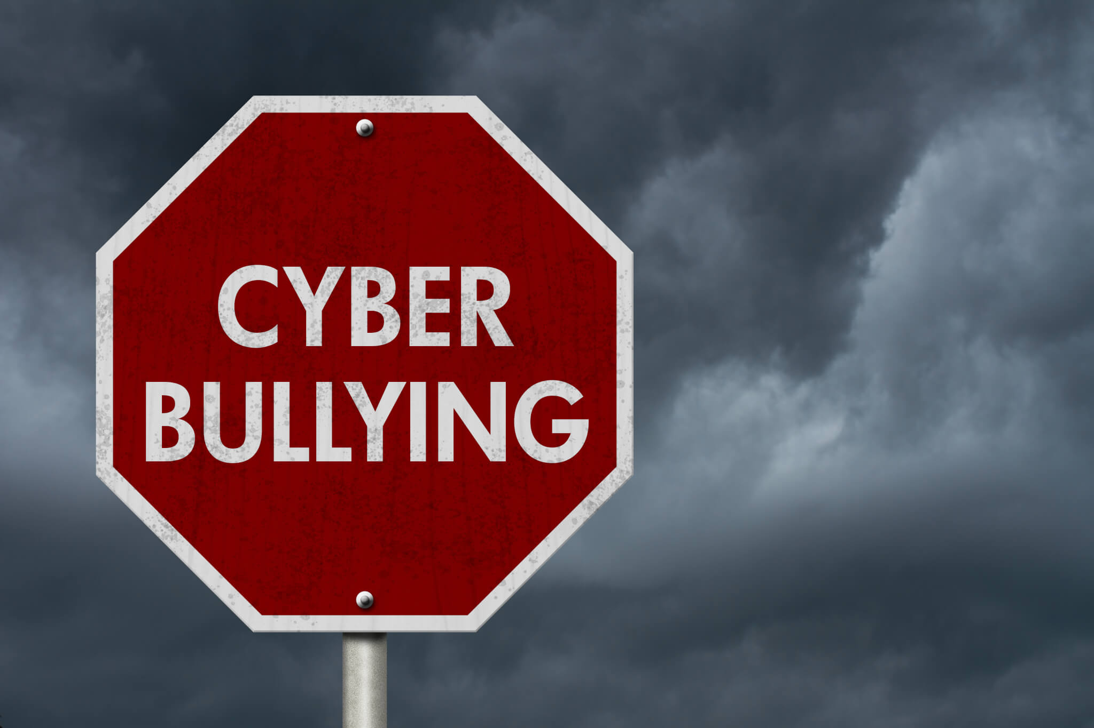
Cyberbulling Detection
By:
John Hani
Mohamed Nashaat
Mostafa Ahmed
Zeyad Emad
Under supervision of :
Dr. Eslam Amer
Eng. Menna Gamil

Slide 2
Agenda
Introduction
Related work
Problem Statement
System overview
Project Deliverables

Slide 3


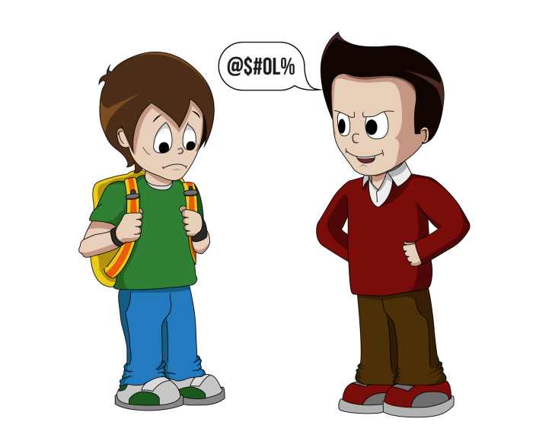
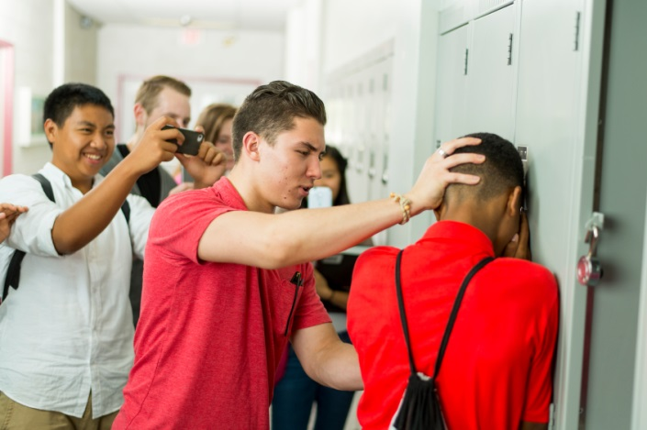
Introduction
Use superior strength or influence to intimidate someone

Slide 4

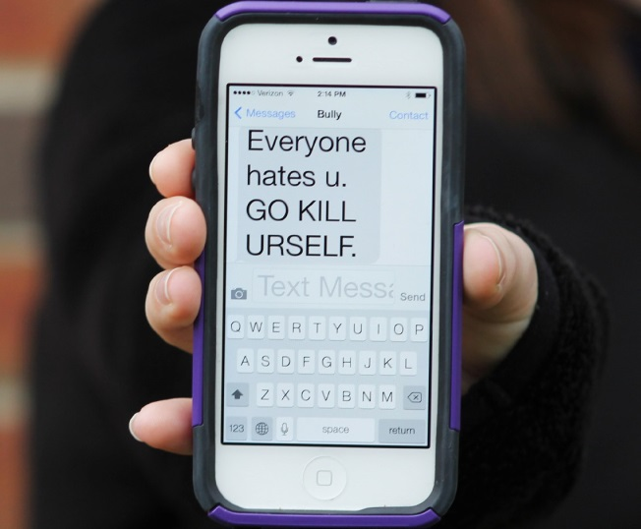
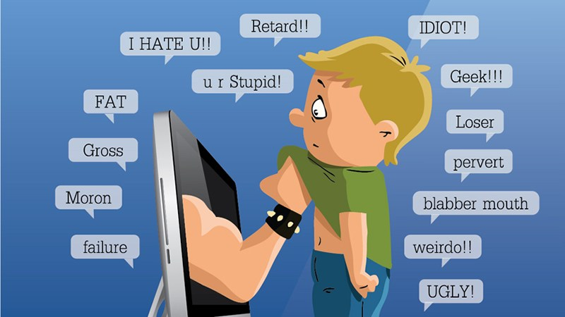
Cyberbullying has been manifesting our youth for quite sometime, due to them being involved in one form of social media communication or another.

Slide 5
More than 1 in 3 young people have experienced cyber threats online.
Over 25 percent of adolescents and teens have been bullied repeatedly through their cell phones or the Internet.
National Crime Prevention Council, “Cyberbullying”
i-SAFE Inc., “Cyber Bullying: Statistics and Tips”
Richard Webster, Harford County Examiner, “From cyber bullying to sexting: What on your kids’ cell?”

Slide 6
Related Work

Slide 7
Problem Statement

Slide 8
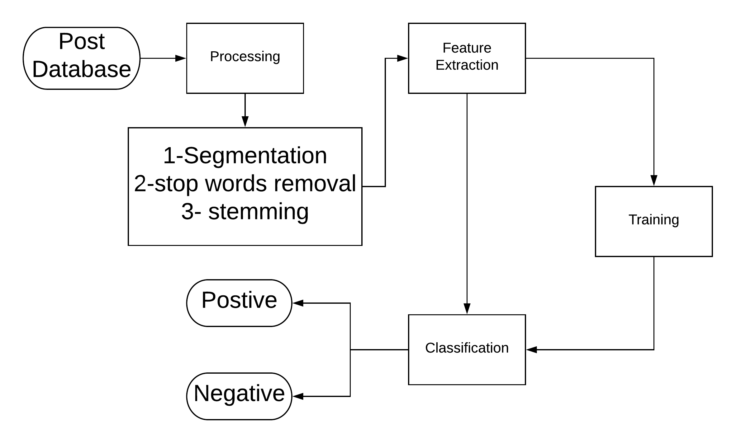
System overview

Slide 9
Input and Preprocessing
-Step 1:We take the posts from database.
-Step 2: Segmentation
-Step 3: Remove Stop words
-Step 4: Stemming of words
-Step 5: Solution for the obfuscation of words

Slide 10
Processing
Sentiment analysis
Context analysis
Deep Learning Classification

Slide 11
Output
-Determination of whether the post is cyberbullying or not.
-Finally, we take steps to prevent this from happening again Like: Alerting Parents and blocking the bully.

Slide 12
4.1 Tasks and Time plan
Task Name | From | To
Idea Discussion | 1/8/2018 | 1/8/2018
Idea Research | 1/8/2018 | 13/9/2018
Proposal Writing | 13/9/2018 | 16/9/2018
Implementing Prototype | 16/9/2018 | 17/9/2018
Delivering Rehearsal | 18/9/2018 | 18/9/2018
Delivering Proposal | 18/9/2018 | 26/9/2018
Doing Survey | 10/10/2018 | 20/10/2018
Implementing Second Prototype | 20/10/2018 | 25/10/2018
Writing SRS | 25/10/2018 | 30/10/2018

Slide 13
4.1 Tasks and Time plan Cont.
Implementing | 30/10/2018 | 25/11/2018
Preparing for External Examiner | 25/11/2018 | 3/12/2018
Implementing | 3/12/2018 | 18/1/2019
Writing SDD | 18/1/2019 | 1/2/2019
Implementing | 1/2/2019 | 1/4/2019
Preparing for Implementation Evaluation | 1/4/2019 | 25/4/2019
Writing 8 Pages Paper | 25/4/2019 | 28/4/2019
Finalizing Implementation | 28/4/2019 | 7/5/2019
Writing Final Thesis | 10/5/2019 | 25/5/2019
Presenting Final Thesis | 25/6/2019 | 25/6/2019

Slide 14
4.2 Budget and Costs $$
No Costs are Needed for this Project up till now

Slide 15
4.3 Supportive Documents
”A Multilingual System for Cyberbully Detection: Arabic Content Detection using Machine Learning” By Batoul Haidar, Maroun Chamoun, Ahmed Serhrouchni.
”Cyberbullying Detection using Time Series Modeling” By Nektaria Potha, Manolis Maragoudakis
”Cybercrime detection in online communications: The experimental case of cyberbullying detection in the Twitter network” By Mohammed Ali Al-garadi , Kasturi Dewi Varathan , Sri Devi Ravana
”Machine Learning Approach for Detection of Cyber-Aggressive Comments by Peers on Social Media Network” By Vikas S Chavan , Shylaja S S
”Machine learning and semantic analysis of in-game chat for cyber bullying” By Shane Murnion , William J Buchanan , Adrian Smales , Gordon Russell
”Unsupervised Cyber Bullying Detection in Social Networks” By Michele Di Capua , Emanuel Di Nardo, Alfredo Petrosino
”Cyberbullying System Detection and Analysis” By Yee Jang Foong , Mourad Oussalah

Slide 16
Any Questions?

